Slide 1
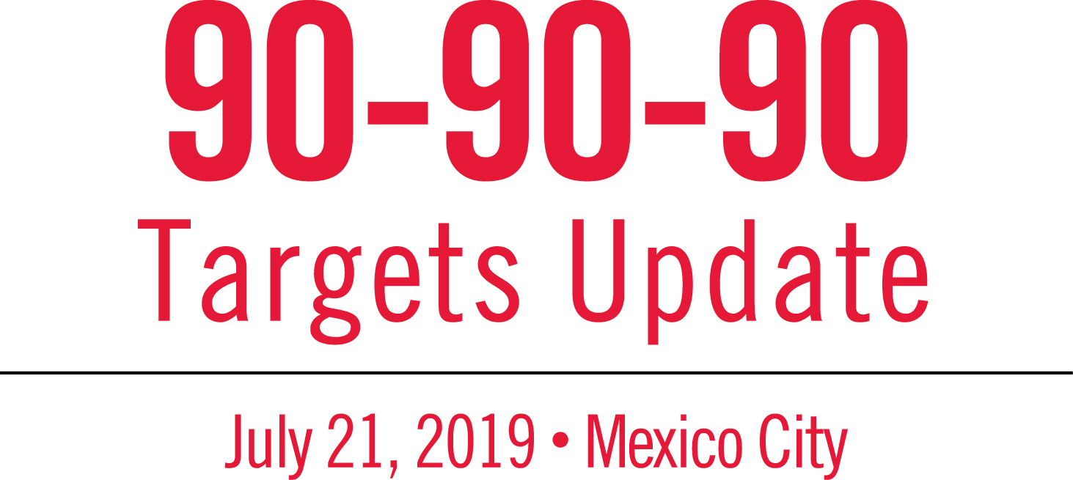

Slide 2
Ending the HIV Epidemic in New York City
Demetre Daskalakis MD MPH
Deputy Commissioner, Disease Control
New York City Department of Health and Mental Hygiene

Slide 3
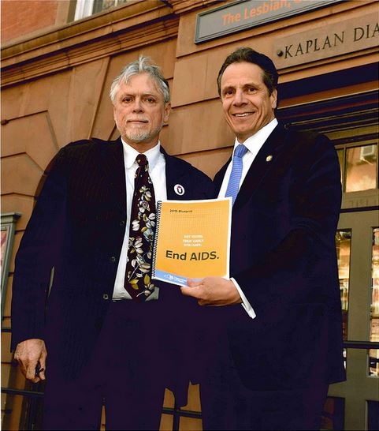
New York State Blueprint for Ending the Epidemic
In April 2015, Governor Andrew Cuomo released the New York State Blueprint for Ending the Epidemic, a set of recommendations by community members, government officials, and providers, expanding on his 2014 three-point plan to:
Identify people with HIV who remain undiagnosed and link them to care;
Link and retain people diagnosed with HIV in care to maximize virus suppression so they remain healthy and prevent further transmission; and
Provide access to PrEP for people at high risk for HIV infection.

Slide 4
New York City Ending the Epidemic Plan
At the World AIDS Day 2015 citywide event, Mayor Bill de Blasio announced the New York City Ending the Epidemic Plan, a four-part strategy building upon the New York State Blueprint to:
Increase access to HIV prevention services, including PrEP and PEP;
Promote optimal treatment for all New Yorkers with HIV;
Enhance methods for tracing HIV transmission; and
Advance sexual health equity for all New Yorkers by promoting access to comprehensive, affirming sexual health care through targeted outreach to priority populations and enhancements to the Health Department’s Sexual Health Clinics.
New York City became a Fast Track City in June, 2016.

Slide 5
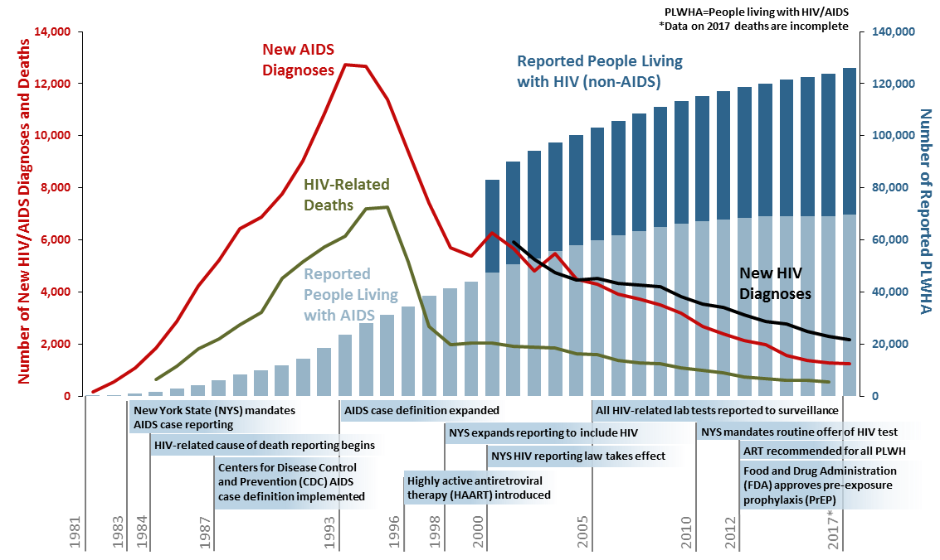
HISTORY OF THE HIV EPIDEMIC IN NYC
As reported to the New York City Department of Health and Mental Hygiene by March 31, 2018.

Slide 6
HIV/AIDS in New York City,
Basic Statistics, 2017
2,157 new HIV diagnoses
25.3 new HIV diagnoses per 100,000 population
1,779 HIV without AIDS
378 HIV concurrent with AIDS (17.5%)
1,239 new AIDS diagnoses
125,884 persons diagnosed, reported, presumed to be living with HIV/AIDS
1,343 deaths among people with HIV/AIDS ¹
Age-adjusted death rate: 7.0 per 1,000 people with HIV/AIDS
Diagnosis rate calculated using DOHMH 2016 population estimate, modified from US Census Bureau intercensal population estimates, updated September 2017. ¹Death rate age-adjusted to the NYC Census 2010 population. Death data for 2017 are incomplete. As reported to the New York City Department of Health and Mental Hygiene by March 31, 2018.
Notes:
Same format as last year’s slide.

Slide 7
New HIV Diagnoses, NYC, 2017
Gender
Age
Borough
Transmission
Risk*
Poverty
(area based, % below FPL)
As reported to the New York City Department of Health and Mental Hygiene by March 31, 2018. *MSM=Men who have sex with men, TG-SC=Transgender people with sexual contact, IDU=People with injection drug use history
Notes:
This graph highlights different demographic characteristics of persons diagnosed with HIV in NYC
We not surprisingly those impacted by racism and other systems of oppression such as homophobia and transphobia
We find men and people of trans experience disproportionately represented among people with new HIV diagnoses in NYC in 2016
Men who are primarily men who have sex with men – primarily Black and Latino MSM
People of trans experience were all trans women – 93% were non-Latina Black or Latina
Among cis women – although smaller number – 90% of new HIV diagnoses were among non-Latina Black or Latina
We also see that because risk is structural that high and very high poverty areas have disproportionate number of HIV diagnoses

Slide 8
HIV Diagnosis Rates¹ among Men and Women in NYC by Race/Ethnicity², 2017
HIV¹ diagnosis rates² among 13-59 year old males³ by race/ethnicity⁴, NYC 2017
HIV¹ diagnosis rates² among 13-59 year old females³ by race/ethnicity⁴, NYC 2017
New HIV Diagnoses
per 100,000 Population
API=Asian/Pacific Islander. ¹Includes diagnoses of HIV without AIDS and HIV concurrent with AIDS. ²Rates calculated using Health Department 2016 population estimates, modified from U.S. Census Bureau intercensal population estimates, updated September 2017. ³Includes transgender men. ⁴Native American and multiracial groups not shown because of small numbers. As reported to the New York City Department of Health and Mental Hygiene by March 31, 2018.
Notes:
In 2017, the HIV diagnosis rate among Black males was 1.4 times higher than the rate among Latino/Hispanic males and over 3 times higher than the rate among White males.
In 2017, the HIV diagnosis rate among Black females was 2.7 times higher than the rate among Latina/Hispanic females and over 10 times higher than the rate among White females.

Slide 9
New Diagnoses and Incidence Estimates¹ NYC, 2013-2017²
¹Using the method in: Song R, et al. Using CD4 data to estimate HIV incidence, prevalence, and percent of undiagnosed infections in the United States. J Acquir Immune Defic Syndr 2017;74(1):3-9. ²2017 incidence estimates are preliminary. As reported to the New York City Department of Health and Mental Hygiene by March 31, 2018.
Notes:
NEW:
HIV incidence surveillance based on the Stratified Extrapolation Approach (SEA) was discontinued in the U.S. as of 2017. A new method is being used nationally and locally to estimate incidence based on distribution of CD4 count at HIV diagnosis to estimate timing of HIV infection. The CD4-depletion model uses parameters based on the U.S. national population. It produces trends in estimated incidence that are consistent with previous SEA-based incidence trends, but annual estimated numbers of new HIV infections that are higher. Estimated HIV incidence overall declined in NYC between 2013 and 2017.
The number of new HIV diagnoses in NYC has been decreasing in recent years, from 2,898 new HIV diagnoses in 2013 to 2,157 new HIV diagnoses in 2017. This represents a 26% decline over the past 5 years.
Citywide, estimated HIV incidence declined significantly between 2013 and 2017.
OLD:
Shows new diagnoses as ascertained by surveillance and estimated incidence based on CDC’s SEA approach. SEA combines results from the Serologic Testing Algorithm for Recent Seroconversion (STARHS) with data on demographic characteristics, risk factor, initial diagnosis date, testing and treatment history from the HIV surveillance registry to estimate the recentness of infection among newly diagnosed persons.
The number of new HIV diagnoses in NYC has been decreasing in recent years, from 3,123 new HIV diagnoses in 2012 to 2,279 new HIV diagnoses in 2016. This represents a 27% decline over the past 5 years.
The number of new HIV diagnoses is stable or declining in all demographic and major HIV transmission risk groups, including MSM overall.
Citywide, estimated HIV incidence declined significantly between 2012 and 2016.

Slide 10
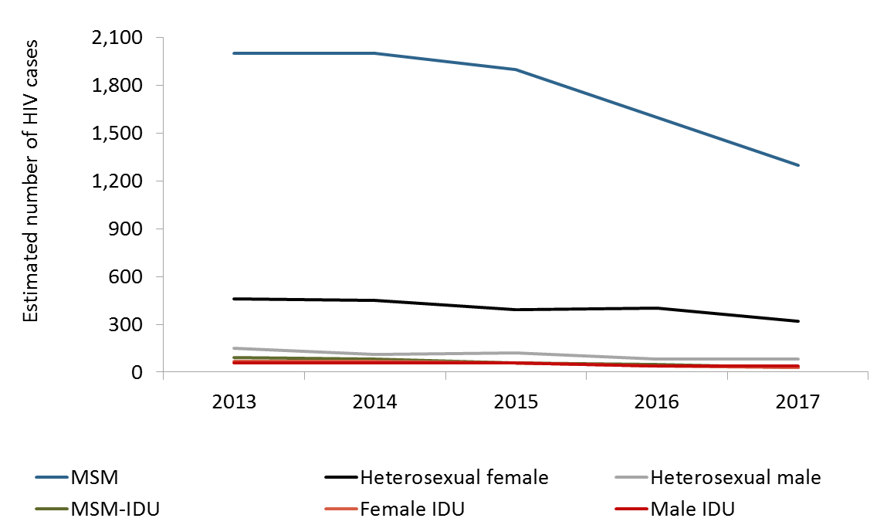
Trends in estimated incident HIV infections¹ by sex at birth and transmission risk, NYC 2013-2017
¹Using the method in: Song R, et al., J Acquir Immune Defic Syndr 2017;74(1):3-9. ²2017 incidence estimates are preliminary. As reported to the New York City Department of Health and Mental Hygiene by March 31, 2018.
Notes:
HIV incidence surveillance based on the Stratified Extrapolation Approach (SEA) was discontinued in the U.S. as of 2017. A new method is being used nationally and locally to estimate incidence based on distribution of CD4 count at HIV diagnosis to estimate timing of HIV infection. The CD4-depletion model uses parameters based on the U.S. national population. It produces trends in estimated incidence that are consistent with previous SEA-based incidence trends, but annual estimated numbers of new HIV infections that are higher. Estimated HIV incidence by transmission risk group (Figure 10.2) declined in NYC between 2013 and 2017.

Slide 11
Proportion of new HIV diagnoses determined to be AHI, NYC, 2008-17
.
As reported to the New York City Department of Health and Mental Hygiene by March 31, 2018.

Slide 12
Proportion of PLWH in NYC Engaged in Selected Stages of the HIV Care Continuum, 2017
Of approximately 90,500 PLWHA in NYC in 2017, 74% had a suppressed viral load.
As reported to the New York City Department of Health and Mental Hygiene by March 31, 2018.
Notes:
“HIV-infected”: calculated as “HIV-diagnosed” divided by the estimated proportion of people living with HIV/AIDS (PLWHA) who had been diagnosed (93.3%), based on a back-calculation method.
Source: NYC HIV Surveillance Registry. Method: Hall HI, et al. Prevalence of Diagnosed and Undiagnosed HIV Infection — United States, 2008-2012. MMWR 2015;64(24):657-662.
“HIV-diagnosed”: calculated as PLWHA “retained in care” plus the estimated number of PLWHA who were out of care, based on a statistical weighting method. This estimated number aims to account for out-migration from NYC, and therefore is different from the number of PLWHA published elsewhere.
Source: NYC HIV Surveillance Registry. Method: Xia Q, et al. Proportions of Patients With HIV Retained in Care and Virally Suppressed in New York City and the United States. JAIDS 2015;68(3):351-358.
“Retained in care”: PLWHA with ≥1 VL or CD4 count or CD4 percent drawn in 2014, and reported to NYC HIV surveillance.
Source: NYC HIV Surveillance Registry.
“Prescribed ART”: calculated as PLWHA “retained in care” multiplied by the estimated proportion of PLWHA who were prescribed ART (96.1%), based on NYC Medical Monitoring Project data.
Source: NYC HIV Surveillance Registry and NYC Medical Monitoring Project, 2014.
“Virally suppressed”: calculated as PLWHA in care with a most recent viral load measurement in 2014 of ≤200 copies/mL, plus the estimated number of out-of-care 2014 PLWHA with a viral load ≤200 copies/mL, based on a statistical weighting method.
Source: NYC HIV Surveillance Registry. Method: Xia Q, et al. Proportions of Patients With HIV Retained in Care and Virally Suppressed in New York City and the United States. JAIDS 2015;68(3):351-358.

Slide 13
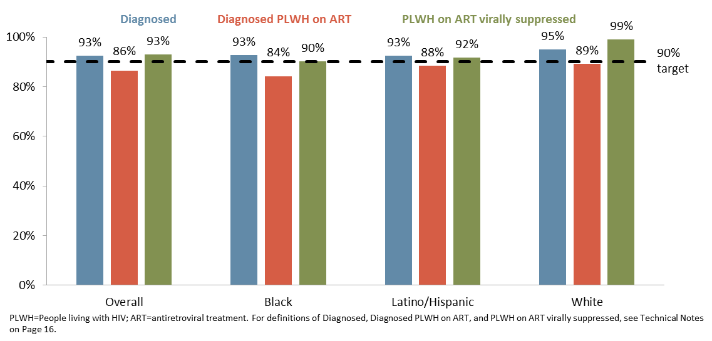
UNAIDS 90-90-90 targets for PLWH in NYC, overall and by race/ethnicity, 2017
As reported to the New York City Department of Health and Mental Hygiene by March 31, 2018.

Slide 15
What does this all mean?
We are diagnosing prevalent HIV infections at a stable rate earlier and more efficiently
Proportion of acute infections detected increasing
Diagnosis at earlier stage of infection, before people get ill. 17.5 % concurrent AIDS
Decreasing incidence means that people are not getting HIV
U=U continues to work
PrEP in MSM is likely driving down transmission
Areas we are working to improve
PrEP in cis Women and TGNC People
Latino MSM- ¡Listos! and more!
NYC IS ON TRACK FOR 2020!

Slide 16
Thank You!
ddaskalakis@health.nyc.gov

